Slide 1
Fake Review predictions
Tay Jia Xing
General Assembly DSI 10

Slide 2
Problem statement / background
More consumers are also relying on online reviews for purchase decision making. Online reviews have become a tool whereby business seeks to improve sales. Business can also be targeted with negative review to tarnish its reputation.
This project aims to train a machine learning classifier model to predict whether a review posted on Yelp is recommended/spam/genuine or not recommended/ham/fake.

Slide 3
Data Source
Labelled dataset for Yelp
Year 2004 – 2015 on restaurants in the US.
358,957 observations (90% genuine reviews and 10% fake reviews)
Class 0
“I had the braised lamb sandwich and was one of the best sandwiches of my life. Do yourself a favour and try this place! Friendly service and cosy atmosphere.”
Class 1
“The food at snack is a selection of popular Greek dishes. The appetizer tray is good as is the Greek salad. We were underwhelmed with the main courses. There are 4-5 tables here so it's sometimes hard to get seated.”

Slide 4

Data cleaning
Downsample – 105,409 observations (65% genuine reviews and 35% fake reviews)
Extract letters only
Remove stopwords
NLTK Lemmatizer
TF-IDF Vectorizer
Model
Model | Accuracy | ROC Score | Recall
Logistic Regression | 0.66 | 0.71 | 0.62

Slide 5
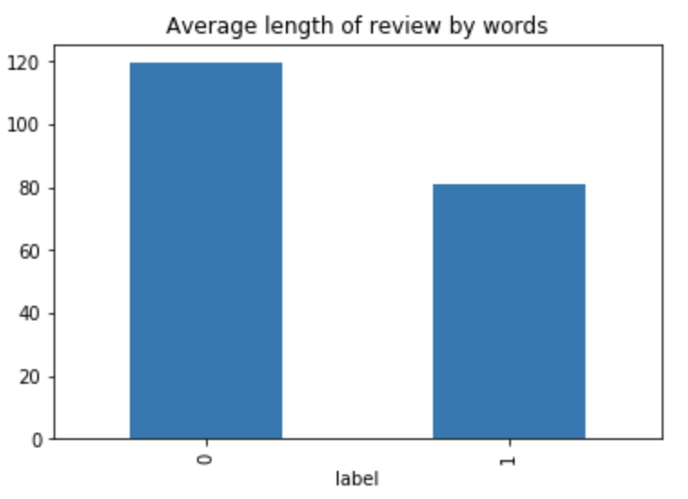
Eda / features engineering
Review Features
Number of words / characters
Syllable count
Number of Uppercase characters
Ratio of uppercase characters
Textblob – Polarity / Subjectivity
SpaCy – POS tags (eg, ADJ, NOUN)
Rating difference
Total 60 review features

Slide 6
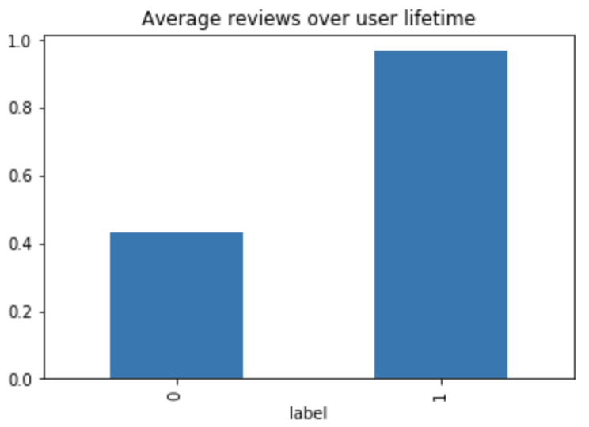
Eda / features engineering
Users Features
Total number of review by each user
Average duration between each review
Number of same day reviews posted
User lifetime
Ratio of no. reviews / lifetime
Ratio of no. reviews / dataset timespan
Ratio of positive & negative ratings
Deviation of user’s rating
Total 20 features

Slide 7
model
Features | Model | Accuracy | ROC | Recall
Review Text | Logistic Regression | 0.66 | 0.71 | 0.66
Review Features | Random Forest | 0.67 | 0.69 | 0.67
User Features | Random Forest | 0.80 | 0.89 | 0.80
User + Review Text | Random Forest | 0.75 | 0.83 | 0.75
User + Review Features | Random Forest | 0.76 | 0.84 | 0.76
User + Review Features (Top 20 features ) | Random Forest | 0.78 | 0.87 | 0.78

Slide 8
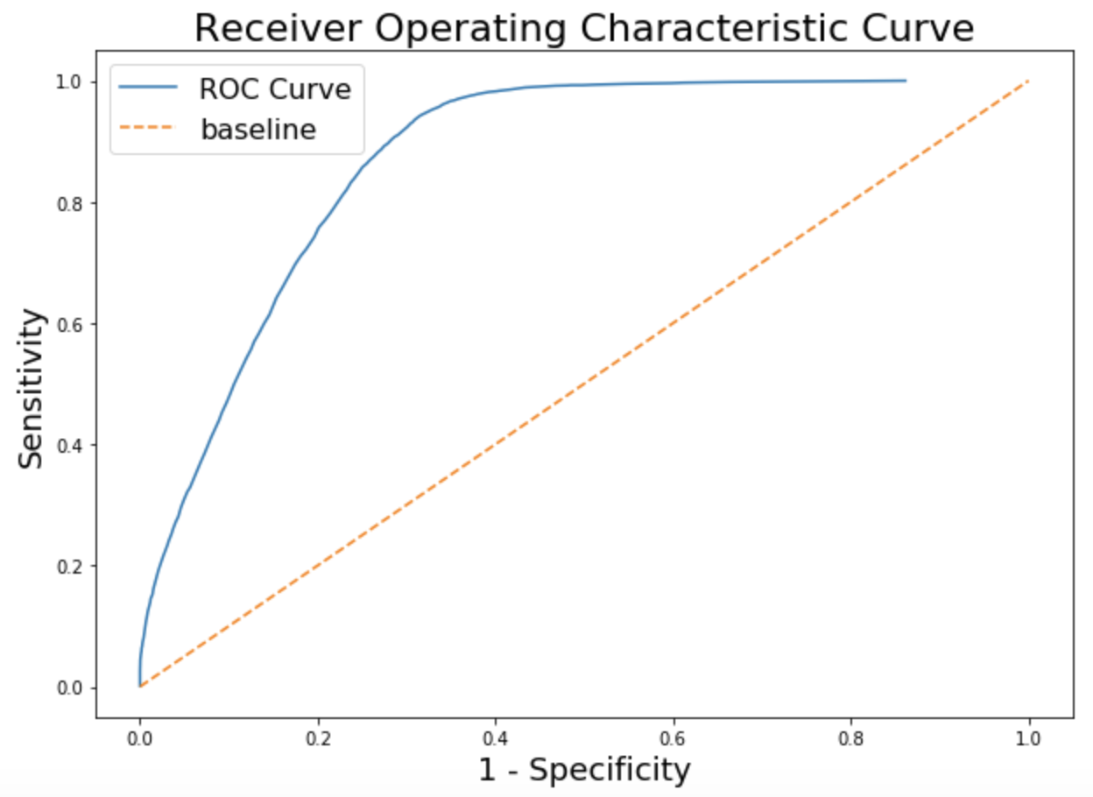
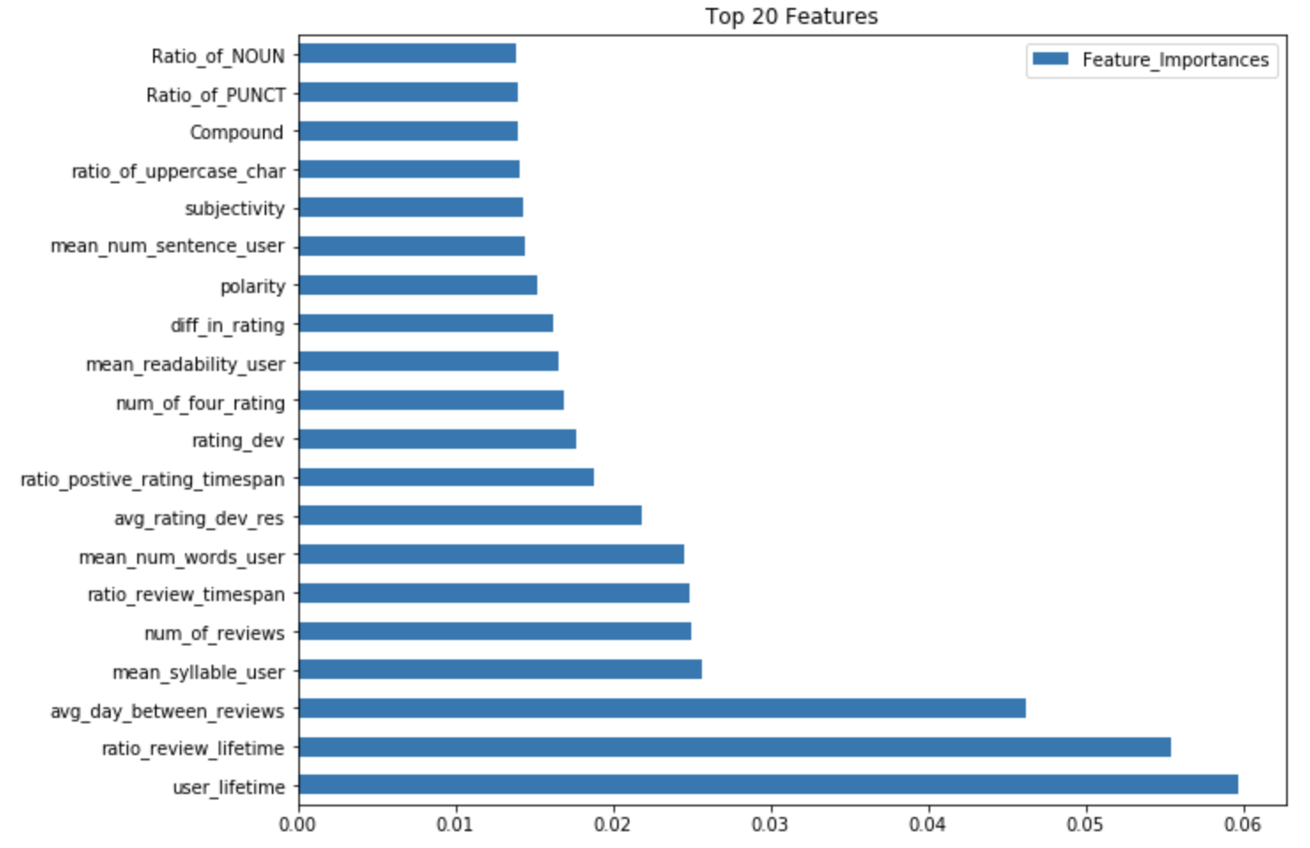
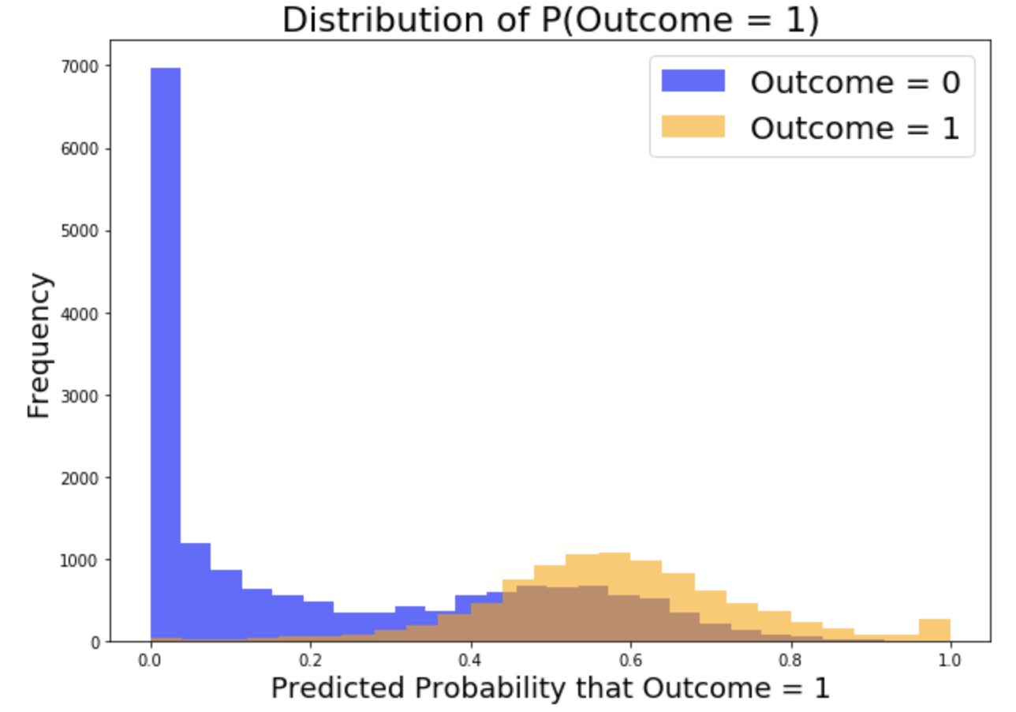
Top 20 features

Slide 9
Conclusion
Based on review text alone, its not sufficient to determine which review are fake or genuine.
Some review features like polarity, subjectively and difference in rating from the restaurant's average rating can be helpful for prediction.
User's behavior is critical to make this prediction.
Limitations of model:
Requires data on user’s behavior over time
Challenge to predict single review users and new users
Cost of misclassification – Reputation lost on restaurant, degraded user experience and creditability of website.

